Slide 1
Introduction and Project Topics
Zonghua Gu

Slide 2
Logistics
Time: Wed 18:30-20:05pm
Location: Cao Guangbiao Main Building 413
Instructor: Zonghua Gu
Office: 老生仪楼一楼
Email: zgu(a)zju.edu.cn
Homepage: http://www.cs.zju.edu.cn/people/zgu/OS/ (under construction)

Slide 3
Grading Scheme
Final Exam: 50%
Project: 50%
I will post some suggested ideas
You can also propose your own project idea
Can be based on your own thesis topic, as long as it is related to OS
Must be approved by me
Notes:
Refer to the “Links and References” page for related conferences and journals for possible ideas

Slide 4
Course Topics (Tentative)
HW fundamentals (multicore, caches, etc.)
Multicore OS
Real-time operating systems (Real-time scheduling)
Case studies: Android; AUTOSAR
Virtualization
Deterministic Multithreading
…

Slide 5
General Comments
Each project group should consist of 1-2 students
I found that large teams often result in freeloaders that don’t contribute.
These are suggested topics; you are free to propose your own topic, as long as I approve them
Topics are classified into hard, medium or easy
If you pick a hard topic, you do not need to finish the whole thing
It is OK to do as much as you can, and explain why sth is too hard to finish
Multiple groups can choose the same general topic, but the specific work details must be different
All references listed here can be obtained with a quick web search. If you cannot find any of them, ask me and I will send to you.
Email discussions are welcome. If more intensive interaction is needed, you can add my QQ: 59331972
A 1-2 page proposal is due on Oct 17 (Wed) by email to zgu@zju.edu.cn; I will give your feedback.

Slide 6
Suggested Topics
Implementation and performance analysis of multicore AUTOSAR OS
Implementing runtime monitoring framework for RTOS
Performance/Power/Energy Analysis of Android or Linux on HW Platform (Easy)
Performance/Power/Energy Analysis of Android or Linux on an emulator (Medium)
Power Management for Android (Medium)
Enhancing OSGi with real-time Java support (Medium)

Slide 8
References

Slide 10
Performance/Power/Energy Analysis of Android or Linux on HW Platform

Slide 11
Performance Analysis of Android or Linux
Run some real-time performance benchmarks on Android running on an embedded HW platform
Can use a laptop computer, or a mobile phone, or an embedded development board.
Can run Java applications on Dalvik VM, or native C applications (e.g., rt-tests, Lachesis…) through JNI (Java-Native Interface)
Can run performance comparisons between Davik applications and Native C applications
Your task: implement one of the techniques in the references

Slide 12
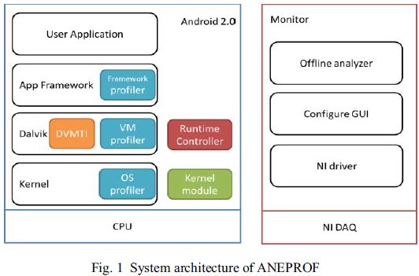
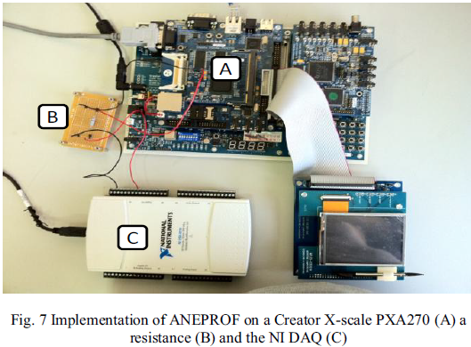
Power/Energy Analysis of Android or Linux
From [Chung11]: log events at 3 different layers with three profilers:
OS profiler,
VM profiler
Framework profiler
I can purchase the NI DAQ for your use
Your task: implement the techniques in [Chung11]
Notes:
a NI (National Instrument) Data Acquisition (DAQ)

Slide 13
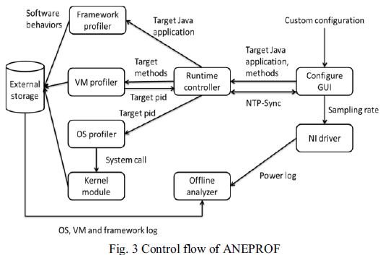

Slide 14
References: Android in General
Donn Felker, Joshua Dobbs, Android Application Development For Dummies, Book
Bernard Cole, Getting a headstart on embedding Android
http://www.eetimes.com/electronics-blogs/other/4236791/Getting-a-headstart-on-embedding-Android-
Juan Gonzales et al, Understanding Android's strengths and weaknesses,
http://www.eetimes.com/design/embedded/4228560/Understanding-Android-s-strengths-and-weaknesses
Frank Maker and Yu-Hsuan Chan, A Survey on Android vs. Linux
http://handycodeworks.com/wp-content/uploads/2011/02/linux_versus_android.pdf
Dominique A. Heger, Mobile Devices - An Introduction to the Android Operating Environment: Design, Architecture, and Performance Implications
http://www.cmg.org/measureit/issues/mit78/m_78_3.pdf
Michael B Motlhabi, Android Power Management
http://www.cs.uwc.ac.za/~mmotlhabi/apm.pdf
Notes:
Juan Gonzales et al, Understanding Android's strengths and weaknesses,
http://www.eetimes.com/design/embedded/4228560/Understanding-Android-s-strengths-and-weaknesses

Slide 15
References: Performance Analysis
Andrea Claudi and Aldo Franco Dragoni, Lachesis: a testsuite for Linux based real-time systems, Real-Time Linux Workshop 2011
https://lwn.net/images/conf/rtlws-2011/proc/Claudi.pdf
RT-Tests
https://rt.wiki.kernel.org/
Bhupinder S. Mongia et al, Reliable Real-Time Applications on Android OS
www.ece.gatech.edu/~vkm/Android_Real_Time.pdf
Arash Rezaei et al, An Application Profiler for Android to identify malicious patterns
Website provides source code, but you need to identify your new contributions in your project
http://www4.ncsu.edu/~arezaei2/CSC714/
Namseung Lee, Sung-Soo Lim, A whole layer performance analysis method for Android platforms, ESTIMedia 2011
Jeremy H. Brown et al, How fast is fast enough? Choosing between Xenomai and Linux for real-time applications, Real-Time Linux Workshop 2010
Carsten Emde, Long-term monitoring of apparent latency in PREEMPT-RT Linux real-time systems, Real-Time Linux Workshop 2010
JNI Related:
Leonid Batyuk et al, Developing and Benchmarking Native Linux Applications on Android, Mobilware 2009
Sangchul Lee and Jae Wook Jeon, Evaluating Performance of Android Platform Using Native C for Embedded Systems, International Conference on Control, Automation and Systems 2010
Cheng-Min Lin et al, Benchmark Dalvik and Native Code for Android System, Second International Conference on Innovations in Bio-inspired Computing and Applications 2011

Slide 16
References: Power/Energy Profiling
Yi-Fan Chung, Chun-Yu Lin, Chung-Ta King, ANEPROF: Energy Profiling for Android Java Virtual Machine and Applications, IEEE 17th International Conference on Parallel and Distributed Systems 2011
Rahul Murmuria, Energy profiling control and control for android devices, MSThesis 2010
http://digilib.gmu.edu:8080/dspace/bitstream/1920/6336/1/Murmuria_thesis_2010.pdf
Jason Flinn, Mahadev Satyanarayanan: PowerScope: A Tool for Profiling the Energy Usage of Mobile Applications. WMCSA 1999: 2-10
Assim Sagahyroon, Battery and Power Consumption of Pocket PCs, JOURNAL OF COMPUTERS, VOL. 7, NO. 1, JANUARY 2012
http://ojs.academypublisher.com/index.php/jcp/article/download/jcp0701147155/4161

Slide 17
Performance/Power/Energy Analysis of Android or Linux on an emulator

Slide 18
Android Emulator
Based on QEMU
Can run Android applications on your desktop workstation to test their functionality, but does not provide timing information, hence cannot be used for performance analysis
Your task:
Implement existing techniques in the references to enable timing analysis within Android emulator
Or, implement new techniques to enable power/energy profiling within Android emulator, based on QEMU-Power

Slide 19
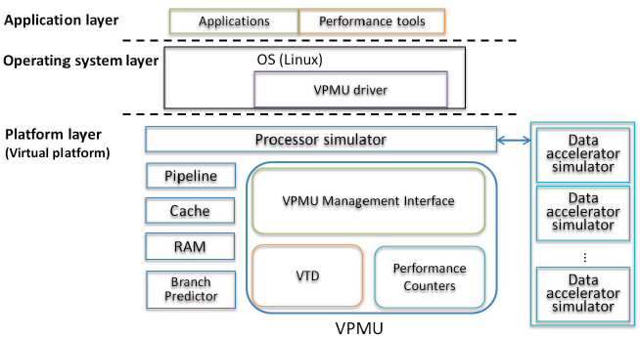
VPMU: Virtual Performance Monitoring Unit (from Lin’s Thesis)

Slide 20
References
Android emulator
http://developer.android.com/guide/developing/tools/emulator.html
电脑端Android模拟器安装使用教程
http://ishare.iask.sina.com.cn/f/22876095.html
Fabrice Bellard, QEMU, a Fast and Portable Dynamic Translator, 2005
Erik van der Kouwe, Porting the QEMU virtualization software to MINIX 3, MS Thesis 2009
http://www.few.vu.nl/~vdkouwe/doc/msc-thesis-cs-erik-van-der-kouwe.pdf
QEMU
http://bellard.org/qemu/
Geng-You Lin, Full-system Profiling of Android/Linux Applications on Virtual Platforms, MS Thesis 2010
http://pas.csie.ntu.edu.tw/wiki/lib/exe/fetch.php?id=public%3Amembers&cache=cache&media=paslab:paslab:r97922089.pdf
Shih-Hao Hung, Tei-Wei Kuo, Chi-Sheng Shih, Chia-Heng Tu: System-wide profiling and optimization with virtual machines. ASP-DAC 2012: 395-400
Antti P. Miettinen, Vesa Hirvisalo, and Jussi Knuuttila, Using QEMU in timing estimation for mobile software development, 1st International QEMU Users' Forum 2011
http://adt.cs.upb.de/quf/quf2011_proceedings.pdf
QEMU-Power:
https://github.com/bboozzoo/qemu-power

Slide 21
Integrating Android with Xenomai or RTAI

Slide 22
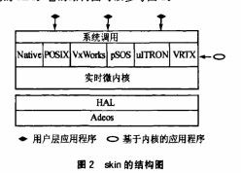
Xenomai/RTAI
RTAI /Xenomai: A patch to the Linux kernel which introduces a hardware abstraction layer
Linux kernel is run as a background task that runs when no real time task is running.
Linux application is able to execute without any modification
Your task: port Android to run on top of RTAI or Xenomai
It is a hard topic, since you need to develop a kernel patch for Android
Android
Notes:
A broad variety of services which make realtime programmers' lifes easier
RTAI provides deterministic response to interrupts, POSIX compliant and native RTAI realtime tasks.
Hard real-time extension to the Linux kernel
Consists of:
1 I/F to Linux HW Management (HAL): basically a data structure.
3 basic components (dispatcher, scheduler, fifo's).
1 I/F (set of functions) used in user tasks to initialize and start the components.
From a Linux point of view these entities populate modules.

Slide 23
References
Xenomai Website
http://www.xenomai.org
实时化解决方案Xenomai的原理及应用
http://embed.chinaitlab.com/linux/874901.html
韩守谦，裴海龙，王清阳, 基于Xenomai的实时嵌入式Linux操作系统的构建,计算机工程与设计, 2011, 32(1)
RTAI Website
https://www.rtai.org/
RTAI分析
http://hi.baidu.com/ilbx/blog/item/717feed17870d5da562c845a.html

Slide 24
Real-Time GPU Scheduling Within Android

Slide 25
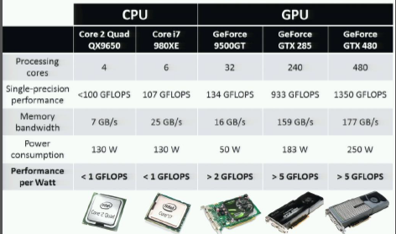
Graphics Processing Units

Slide 26
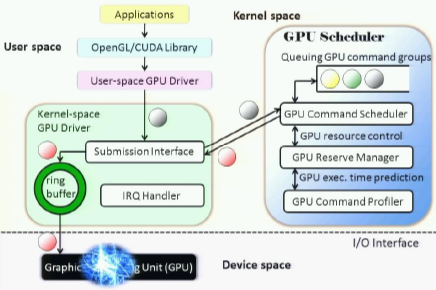
GPU Scheduling
Conventional GPU adopts FIFO task scheduling
TimeGraph: implement priority queuing & resource reservation on CPU in Linux kernel
Your task: port TimeGraph to run on Android

Slide 27
References
Shinpei Kato, TimeGraph
http://rtml.ece.cmu.edu/projects/timegraph/
System Software Support for GPU-accelerated Applications, talk at Microsoft, 2010
http://research.microsoft.com/apps/video/default.aspx?id=141120&l=i

